Slide 1
The Android User Interface

Slide 2
The R class
R.java is a dynamically generated class
Created during build process to dynamically identify all assets (from strings to android widgets to layouts), for usage in java classes in Android app (can find it under gen/PACKAGE/R.java)
The various values defined in the res files
R.java is Android specific, so it doesn't have much to do with Java language constructs
Contains ONLY public constants (public static final).
android:id="@+id/btnAbout“
Compiler generates a constant in the R file

Slide 3
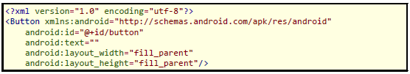
Element attributes
One of the most important attributes for Android elements is the id attribute.
Because we usually want to reference elements from our Java code, we need to give them an identifier via the android:id attribute.
For example, in the code below the button widget has an id attribute called button which we can use to reference it in our Java code

Slide 4
Element attributes
The text attribute in this case is empty but we could use it to display text on our button.
The width and height attributes are similar to those of the ViewGroups
If we have an element in our XML file that we do not need to reference in the Java file, such as a static label using the TextView, then we do not need to have an android:id attribute to give them a name.

Slide 5
Using the id attribute
The id attribute can be used to reference the element in our Android program as follows:
Button btn = (Button)findViewById(R.id.btnOkay);
Now use btn to reference our button in our Java code.

Slide 6
Widgets
In the Android toolkit the widgets include TextViews, Buttons, Checkboxes, Radiobuttons and several other elements.
The simplest widget is the label, referred to in Android as a TextView.
Bits of text not editable directly by users.
Typically, they are used to identify adjacent widgets (e.g., a "Name:" label before a field where one fills in a name).

Slide 7
TextViews
In Java, you can create a label by creating a TextView instance.
More commonly, though, you will create labels in XML layout files by adding a TextView element to the layout, with an android:text property to set the value of the label itself.

Slide 8
TextViews
TextView has numerous other properties of relevance for labels:
android:typeface to set the typeface to use for the label (e.g., monospace)
android:textStyle to indicate that the typeface should be made bold (bold), italic (italic), or bold and italic (bold_italic)
android:textColor to set the color of the label's text, in RGB hex format (e.g., #FFFF0000 for red)
Button is a subclass of TextView, so everything discussed fpr TextView in terms of formatting the face of the button still holds

Slide 9
Buttons and Images
Android has two widgets to help you embed images in your activities:
ImageView and ImageButton
As the names suggest, they are image-based analogues to TextView and Button, respectively.
Each widget takes an android:src attribute (in an XML layout) to specify what picture to use.

Slide 10
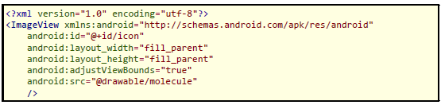
Buttons and Images
Example of ImageView
ImageButton, a subclass of ImageView, mixes in the standard Button behaviors, for responding to clicks, but at the same time inherits all of the properties of the ImageView.

Slide 11
EditText
Along with buttons and labels, fields are the third "anchor" of most GUI toolkits.
In Android, they are implemented via the EditText widget, which is a subclass of the TextView used for labels.
The EditText widget is used to allow the program to read a text string entered by the user.

Slide 12
EditText
Along with the standard TextView properties, EditText has many others that will be useful for you in constructing fields, including:
android:autoText, to control if the field should provide automatic spelling assistance
android:capitalize, to control if the field should automatically capitalize the first letter of entered text (e.g., first name, city)
android:digits, to configure the field to accept only certain digits
android:singleLine, to control if the field is for single-line input or multiple-line input (e.g., does <Enter> move you to the next widget or add a newline?)

Slide 13
CheckBox
Checkbox has two states: checked and unchecked. Clicking the checkbox toggles between those states to indicate a choice (e.g., "Add rush delivery to my order").
CheckBox widget has TextView as an ancestor, so you can use TextView properties like android:textColor to format the widget

Slide 14
CheckBox
Within Java, you can invoke:
isChecked() to determine if the checkbox has been checked
setChecked() to force the checkbox into a checked or unchecked state
toggle() to toggle the checkbox as if the user checked it
Also, you can register a listener object (in this case, an instance of OnCheckedChangeListener) to be notified when the state of the checkbox changes.

Slide 15
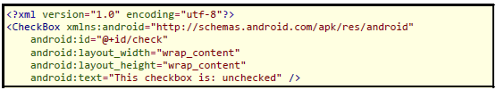
CheckBox
For example, from the Basic/CheckBox project, here is a simple checkbox layout:

Slide 16
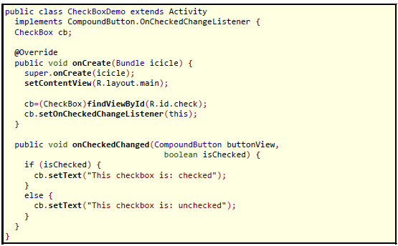
CheckBox
The corresponding java retrieves and configures the behavior of the checkbox:

Slide 17
ToggleButton
Similar widget to CheckBox
Like CheckBox, ToggleButton is a two-state widget that is either checked or unchecked
However, ToggleButton has a distinct visual appearance and does not have associated text
Otherwise, ToggleButton behaves much like CheckBox.

Slide 18

ToggleButton
You can put it in a layout file, as seen in the Basic/ToggleButton sample:
You can also set up an OnCheckedChangeListener to be notified when the user changes the state of the ToggleButton.

Slide 19
RadioButton
Radio buttons are two-state, like checkboxes, but can be grouped such that only one radio button in the group can be checked at any time
Like CheckBox, RadioButton inherits from CompoundButton, which in turn inherits from TextView
Similarly, can call isChecked() on a RadioButton to see if it is selected, toggle() to select it, and so on, like with a CheckBox

Slide 20
RadioGroup
Most times, you will want to put your RadioButton widgets inside of a RadioGroup
The RadioGroup indicates a set of radio buttons whose state is tied, meaning only one button out of the group can be selected at a time
Assign an android:id to your RadioGroup in your XML layout, then access the group from Java and invoke:
check() to check a specific radio button via its ID (e.g., group.check(R.id.rdoDebit))
clearCheck() to clear all radio buttons, so none in the group are checked
getCheckedRadioButtonId() to get the ID of the currently-checked radio button (or -1 if none are checked)

Slide 21
RadioGroup
For example, from the Basic/RadioButton sample application, the next slide shows a XML layout showing a RadioGroup wrapping a set of RadioButton widget
Note that the radio button group is initially set to be completely unchecked at the outset.
To preset one of the radio buttons to be checked, use either setChecked() on the RadioButton or check() on the RadioGroup from within your onCreate() callback in your activity.

Slide 22
